Slide 1


Moving out of the Comfort Zones:
Desired Shifts in NLP Benchmarking
Ido Dagan
Bar-Ilan University

Slide 2
Motivation
NLP made huge progress recently, becoming practical for many applied settings
On the other hand, there are many more settings for which leveraging NLP would be great, but NLP isn’t practical for them yet
Where current approaches often seem to have their glass ceilings in challenging settings
This talk: three proposed directions for NLP benchmarking, which may help driving further NLP scope:
Simulating realistic data scenarios
Benchmarking interactive NLP applications
Revisiting benchmarking of semantic & open knowledge representations
Notes:
Methodological, application, infrastructure,

Slide 3
Simulating Realistic Data Scenarios
& exposing technology inadequacy over them

Slide 4
Realistic vs. “Comfort Zone” Benchmarks
Comfort zones
Easier to collect the data
Easier to model it
Everyone is happy…
But what is “realistic”?
The developed models are aimed to be useful in some practical settings, over real-life data
Hence, benchmarks should simulate, as much as possible, such settings, data and downstream use
In this part:
Three examples for making benchmarks more realistic
Few-shot relation classification, cross-document coreference, revisiting RTE/NLI
Notes:
Few-Shot Learning model for Relation Classification.

Slide 5



Revisiting Few-Shot Relation Classification Evaluation Data and Classification Schemes
Ofer Sabo, Yanai Elazar, Yoav Goldberg, and Ido Dagan
Accepted to Transactions of ACL (TACL)
Notes:
excited to talk here.
Add a slide about yourself.
want to hear feedback on the work and presentation.

Slide 6
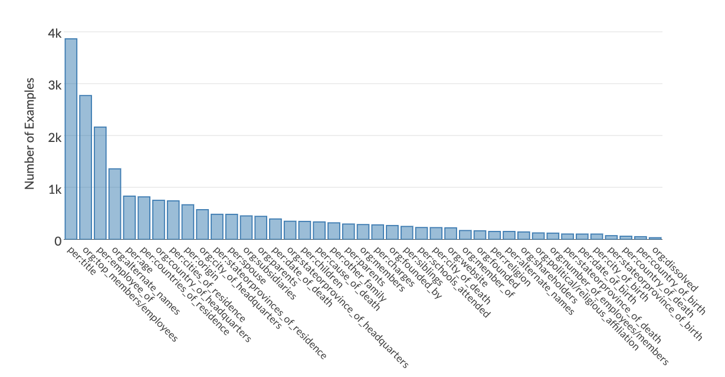
Relation Classification (RC) Datasets - “Supervised”
RC instance: given two entity mentions, classify the relation between them
A dataset annotates a set of target relations
Sampling RC instances from a corpus
Some instances correspond to one of the target relations.
Many correspond to the NOTA category (None-Of-The-Above).
TACRED (Zhang et al., 2017): 41 target relations; ~ 80% of instances correspond to NOTA.
Notes:
Often with hundreds of annotated examples per category

Slide 7
Few-Shot Relation Classification Datasets
The few-shot setting is much more realistic for practical RC/RE
The FewRel dataset (Han et al., 2018)
The first Few-Shot Relation Classification dataset
Setup:
Many background relations with full training data, to develop a “generic” RC model,
Few new target relations for test, each with few (shot) training examples
Evaluation Based on “episodes”: each sampling a different few-shot scenario
A large dataset: 80 training relation classes and 20 test classes, each with 700 instances
FewRel 2.0: extending with the NOTA category (Gao et al., 2019)
Encouraged research on the important few-shot setting
Notes:
Few-Shot Learning model for Relation Classification.

Slide 8
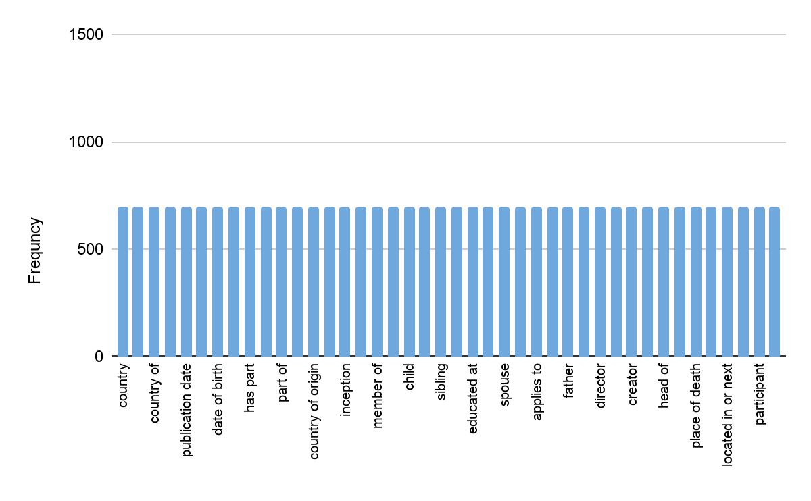
However...
The FewRel dataset lacks important realistic properties:
Covering all entity types, including pronouns and common nouns
FewRel: only named entities.
The boy was born in Tennessee.
She is Emily’s Mother.
Including relation instances with no actual relation
FewRel: all instances correspond to the dataset relations.
Although he works in London, they met in Tel-Aviv.
Realistic relation distribution
FewRel: same number of instances for all relation types
Realistic/natural NOTA rate
FewRel: low arbitrary NOTA rates (15% or 50%)
In a realistic few-shot distribution we found ~ 95% of candidate instances correspond to NOTA
Notes:
Few-Shot Learning model for Relation Classification.

Slide 9
Consequently: the FewRel dataset is easy
Those properties oversimplify the Few-Shot Relation Classification challenge
Making the task much easier than a realistic setting
Yielding seemingly high performance: ~ 80-85% accuracy even in the 1-shot setting.
Our goal: obtain a more realistic data composition
Notes:
Few-Shot Learning model for Relation Classification.

Slide 10
Revisiting the TACRED Dataset
The TACRED RC dataset, initially created for the supervised setting (rather than few-shot), satisfies (to some extent) the four desired properties:
Contains named-entities, pronouns and common nouns.
A natural relation-distribution sampled from the source corpus
Includes “No Relation” instances
Naturally distributed NOTA rate
But TACRED is a supervised dataset...
Notes:
Mention Shachar roseman paper

Slide 11
Transforming from Supervised to Few-Shot
Main difference: same vs. different categories in train-test splits
Goal: preserving the “original” corpus-based distribution of relations
A general transformation scheme, applicable to any supervised RC dataset
Given a supervised dataset with C categories:
Pick M categories out of C as the test relations
The remaining (C - M) categories are train & dev relations.
Keep the original train/dev/test splits of the instances
Relabel the instances in each split:
Test set instances whose labels are within M retain their original labels.
All other test instances are labeled as NOTA.
An analogous process for train/dev splits
⇒ Resulting in splits with distinct relation labels

Slide 12
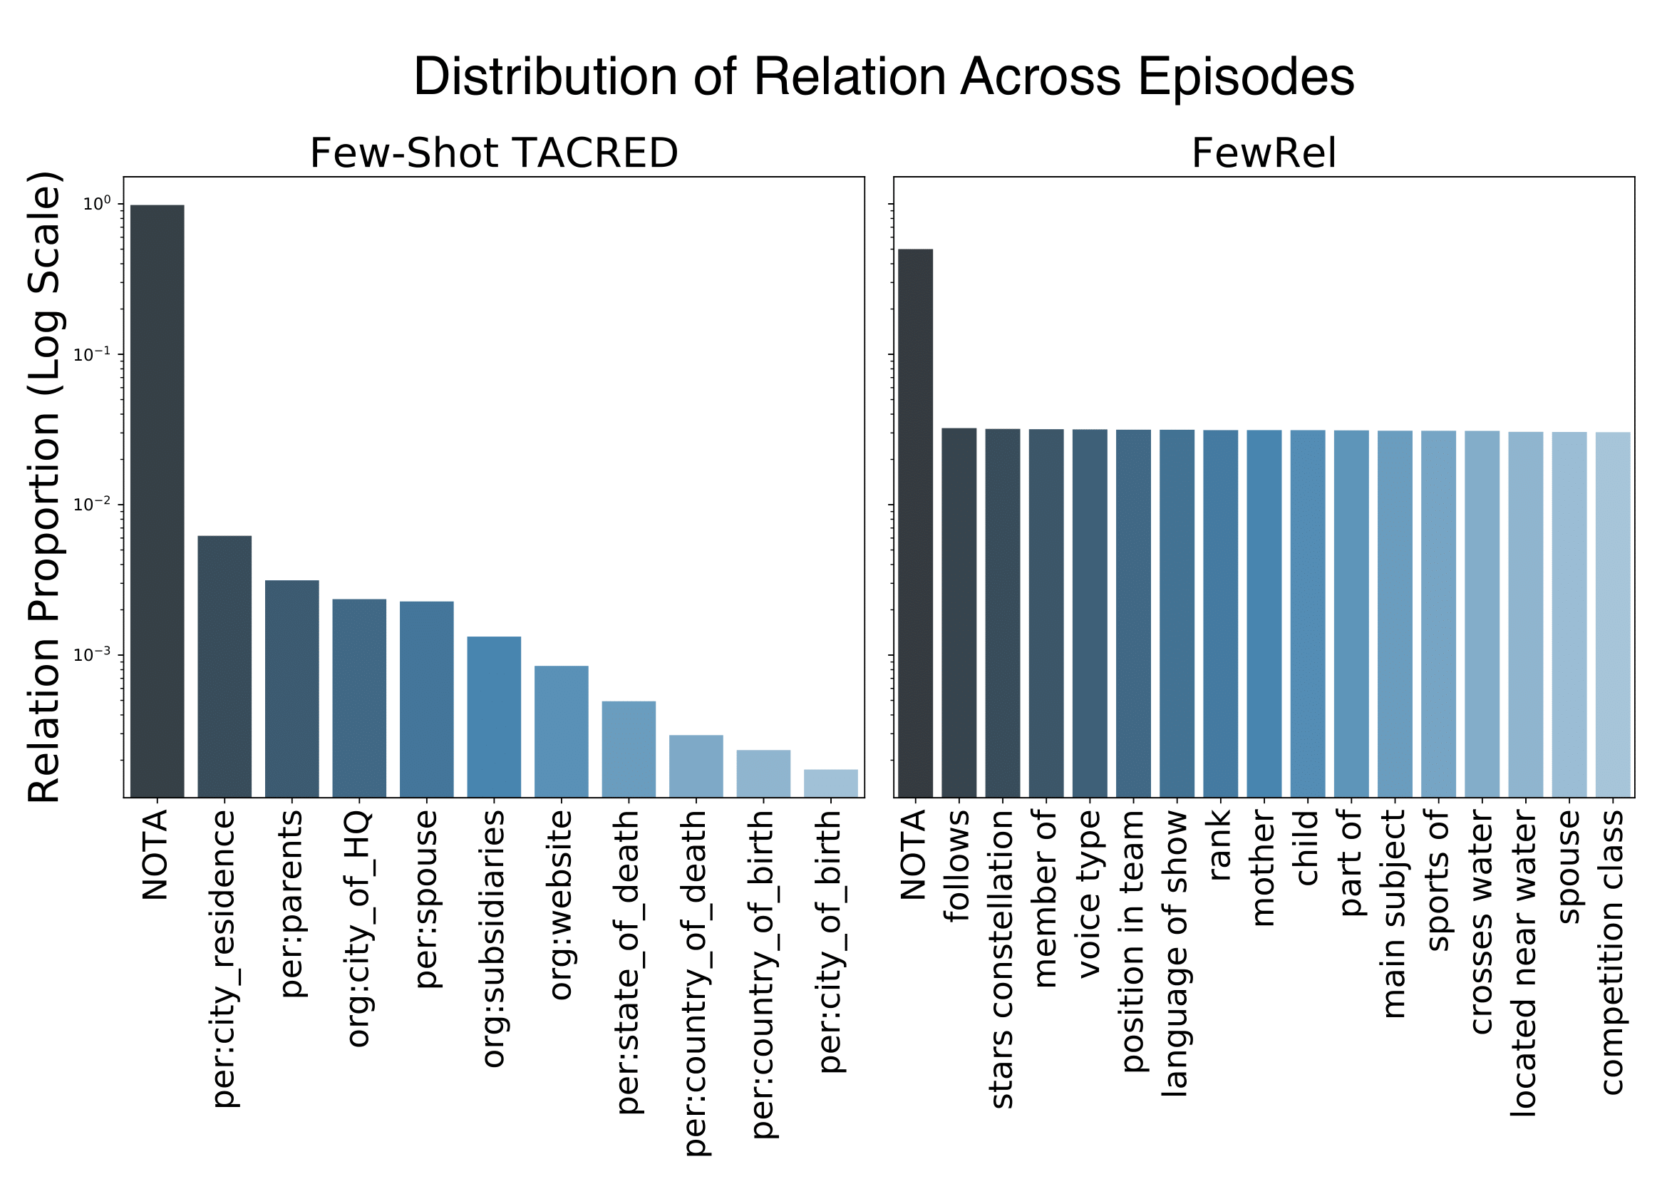
Transforming TACRED to Few-Shot TACRED
Few-Shot TACRED Relation Distribution
FewRel Relation Distribution
97.5%
50%
R₁
R₂
R₃
R₄
R₅
R₆
R₇
R₈
R₉
R₁₀
R₁
R₂
R₃
R₄
R₅
R₇
R₆
R₈
R₉
NOTA
NOTA
R₁₀
Notes:
Few-Shot Learning model for Relation Classification.

Slide 13
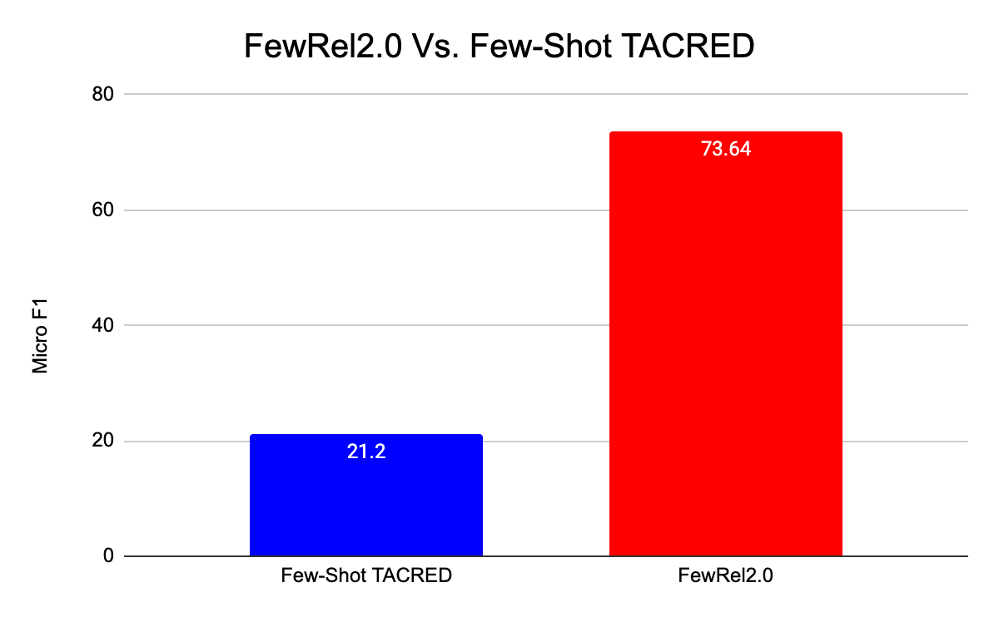
Takeout: Few-Shot TACRED
Few-Shot TACRED represents a much more realistic few-shot RC setting
Hence, it’s much more challenging - evident by performance of SOTA model
Exposing that current models don’t match up for the the few-shot setting!

Slide 14





Realistic Evaluation Principles for Cross-document Coreference Resolution
Arie Cattan, Alon Eirew, Gabriel Stanovsky, Mandar Joshi and Ido Dagan
*SEM 2021
Notes:
Hi Everyone, my name is Arie Cattan and I’ll present my work about Cross-document….

Slide 15
Unrealistic Evaluation Practices for CD-Coref SOTA
High reported results, over ECB+, don’t reflect realistic performance
Notes:
We observe that the high reported results don’t reflect realistic performance

Slide 16
Unrealistic Evaluation Practices for CD-Coref SOTA
High reported results don’t reflect performance in real-world scenarios
Evaluating only on gold mentions → coreference resolution involves also mention detection
Notes:
First, models are evaluated only on gold mentions, whereas coref involves also mention detection

Slide 17
Unrealistic Evaluation Practices for CD-Coref SOTA
High reported results don’t reflect performance in real-world scenarios
Evaluating only on gold mentions → coreference resolution involves also mention detection
Considering, and rewarding, singleton prediction in coreference metrics
Notes:
Second, singletons are rewarded and distort results

Slide 18
Unrealistic Evaluation Practices for CD-Coref SOTA
High reported results don’t reflect performance in real-world scenarios
Evaluating only on gold mentions → coreference resolution involves also mention detection
Considering, and rewarding, singleton prediction in coreference metrics
Sidestepping a major lexical ambiguity challenge
Notes:
Models sidestep lexical ambiguity

Slide 19
Unrealistic Evaluation Practices for CD-Coref SOTA
High reported results don’t reflect performance in real-world scenarios
Evaluating only on gold mentions → coreference resolution involves also mention detection
Considering, and rewarding, singleton prediction in coreference metrics
Sidestepping a major lexical ambiguity challenge
Notes:
Let’s explain how singletons affect the evaluation

Slide 20
Downstream Application of Coreference Resolution
Consider this question-answering example from Quoref (Dasigi et al., 2019)
Anna and Declan eventually make their way on foot to a roadside pub, where they discover the three van thieves going through Anna’s luggage. Declan fights them, displaying unexpected strength for a man of his size, and retrieves Anna’s bag.
Who does Declan get into a fight with?
Notes:
To illustrate the effect of singletons in coreference evaluation, let’s start with a typical downstream application that involve coreference, question-answering.
To answer this question, we need to be able to identify that “them” corefer with “three van thieves”

Slide 21
Downstream Application of Coreference Resolution
Consider this question-answering example from Quoref (Dasigi et al., 2019)
Anna and Declan eventually make their way on foot to a roadside pub, where they discover the three van thieves going through Anna’s luggage. Declan fights them, displaying unexpected strength for a man of his size, and retrieves Anna’s bag.
Who does Declan get into a fight with?

Slide 22
Downstream Application of Coreference Resolution
Consider this question-answering example from Quoref (Dasigi et al., 2019)
Anna and Declan eventually make their way on foot to a roadside pub, where they discover the three van thieves going through Anna’s luggage. Declan fights them, displaying unexpected strength for a man of his size, and retrieves Anna’s bag.
Who does Declan get into a fight with?
Three van thieves
Notes:
And answer the right question

Slide 23
Downstream Application of Coreference Resolution
Consider this question-answering example from Quoref (Dasigi et al., 2019)
Anna and Declan eventually make their way on foot to a roadside pub, where they discover the three van thieves going through Anna’s luggage. Declan fights them, displaying unexpected strength for a man of his size, and retrieves Anna’s bag.
Who does Declan get into a fight with?
Three van thieves
Downstream tasks leverage coreference links, available from non-singleton clusters, to bridge information across mentions
Notes:
The takeout from this example is that downstream tasks leverage coreference links to bridge information

Slide 24
Singleton Effect
Three van thieves, them
path
pub
fights
Gold:
discover
retrieves
Declan, his, Declan
Notes:
Assuming that the gold is composed of 5 singletons and 2 non-singleton clusters.

Slide 25
Singleton Effect
Three van thieves, them
path
pub
fights
Gold:
discover
retrieves
Declan, his, Declan
path
pub
fights
Retrieves, Three van thieves, them, Declan, his, Declan
S1
discover
Notes:
S1 identifies all singletons but wrongly merged the non-singleton clusters

Slide 26
Singleton Effect
Three van thieves, them
path
pub
fights
Gold:
discover
retrieves
Declan, his, Declan
path
pub
fights
Retrieves, Three van thieves, them, Declan, his, Declan
S1
discover
Three van thieves, them
S2
Eventually make
Declan, his, Declan, retrieves
Notes:
S2 is the opposite. perform poorly singleton predictions but predicts well the two cluster (with only one mistake)

Slide 27
Singleton Effect
Three van thieves, them
path
pub
fights
Gold:
discover
retrieves
Declan, his, Declan
path
pub
fights
Retrieves, Three van thieves, them, Declan, his, Declan
S1
discover
Three van thieves, them
S2
Eventually make
Declan, his, Declan, retrieves
From a coreference resolution perspective, S2 is a better model!
Notes:
Because S2 could answer the question and not S1

Slide 28
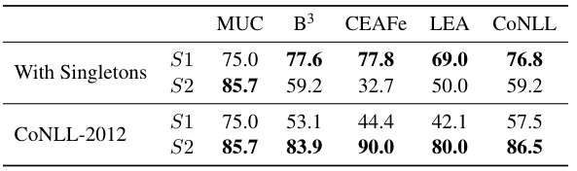
Evaluation with or without singletons
Including singletons in coreference metrics may lead to counterproductive results for downstream tasks!
Notes:
However, when we include singletons in coreference metrics, S1 is much higher than s2 which is counterproductive for downstream tasks

Slide 29
Evaluation with or without singletons
Focusing the evaluation on links → S2 gets higher results than S1, as desired
Notes:
When focusing the evaluation only on links (ignore singletons like in conll-2012), S2 gets higher results than s1 as we expected

Slide 30
Evaluation with or without singletons
Focusing the evaluation on links → S2 gets higher results than S1, as desired
Models are still penalized for wrongly linking singletons
Notes:
It’s important to note that even models are still penalized for wrongly linking singletons

Slide 31
Evaluation with or without singletons
Focusing the evaluation on links → S2 gets higher results than S1, as desired
Models are still penalized for wrongly linking singletons
But singletons are still valuable for mention prediction ...

Slide 32
Evaluation with or without singletons
Decouple the evaluation of mention detection from coreference resolution
Notes:
We propose to decoupe ...

Slide 33
Evaluation with or without singletons
Decouple the evaluation of mention detection from coreference resolution
Mention detection (with singletons) is a span detection task → Span F1
Coreference is a linking task → CoNLL-2012 (without singletons)
Notes:
Mention detection is basically ...

Slide 34
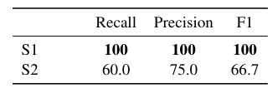
Evaluation with or without singletons
Coreference Results
Mention detection Results
Decouple the evaluation of mention detection from coreference resolution
Mention detection (with singletons) is a span detection tasks → Span F1
Coreference is a linking task → CoNLL-2012 (without singletons)
Notes:
More faifthfull interpretation of the results

Slide 35
Unrealistic Evaluation
High reported results don’t reflect performance in real-world scenarios
Evaluating only on gold mentions → coreference resolution involves also mention detection
Considering, and rewarding, singleton prediction in coreference metrics
Sidestepping a major lexical ambiguity challenge (skipped)
Notes:
The first point is obvious

Slide 36
Results — Event coreference on ECB+
 | CoNLL F1
Barhom et al. (2019) | 79.5
Cattan et al. (2021) | 81
Notes:
When evaluated on gold mentions, our model outperforms the joint model

Slide 37
Results — Event coreference on ECB+
 | CoNLL F1
Barhom et al. (2019) | 79.5
Cattan et al. (2021) | 81
— singletons | 71.1 (-9.9)
Notes:
Removing singletons from the evaluation leads in a performance drop of 9.9

Slide 38
Results — Event coreference on ECB+
 | CoNLL F1
Barhom et al. (2019) | 79.5
Cattan et al. (2021) | 81
— singletons | 71.1 (-9.9)
— topic level | 62.0 (-9.1)
Notes:
Lexical ambiguity challenge also decreases the performance by 9.1

Slide 39
Results — Event coreference on ECB+
 | CoNLL F1
Barhom et al. (2019) | 79.5
Cattan et al. (2021) | 81
— singletons | 71.1 (-9.9)
— topic level | 62.0 (-9.1)
— predicted mentions | 48.6 (-13.4)
Notes:
Finally, using predicted mentions causes a drop of 13.4 points

Slide 40
Takeout
3 evaluation aspects for assessing performance realistically:
Predicted mentions
Decouple coreference and mention-detection evaluation
Evaluation at the entire topic level
Applying our evaluation methodology on a SOTA model results in a drop of 32.4 CoNLL F1 (!)
Huge need for model improvement to address realistic settings!
Notes:
Mention: also our experience when trying to use in a downstream task

Slide 41
Revisiting RTE/NLI Benchmarking

Slide 42
“Realistic” RTE/NLI Benchmarking?
Recognizing Textual Entailment (RTE, later termed NLI) is a generic infrastructure NLP task (Dagan et al., 2005)
RTE is an appealing task since it captures semantic inferences in many downstream tasks, which can be reduced to entailment recognition
What does it mean then to have a “realistic” textual entailment benchmark?

Slide 43
It’s all about entailment
Question Expected answer template Who acquired Overture? >> X acquired Overture
Yahoo’s buyout of Overture ...
Yahoo acquired Overture
entails
given text
hypothesized answer
Application inferences are reducible to entailment!
RE: X acquire Y
Summarization (inc. multi-document): identify redundancy, verify factuality
MT evaluation: test for equivalence of system vs. reference translation
Educational applications: student vs. reference answer
Notes:
In this slide - explain the reduction (in the next - the benchmark creation)

Slide 44
Proposal: Revisit RTE/NLI Benchmarking
The early RTE datasets were based on instances from datasets of other applications (QA, RE, summarization), transformed into RTE instances
Based on the corresponding inference reductions (as just exemplified)
Representing realistic downstream-task cases
Usually both premise and hypothesis were based on original texts
The SNLI/MNLI datasets collected text premises, but asked crowdworkers to synthetically generate a hypothesis for each entailment category
(Bowman et al., 2015; Williams et al., 2018)
Proposal: derive RTE/NLI datasets from large-scale datasets, and system outputs, for inference-involving tasks, to improve downstream relevancy
Reading comprehension, Fact Verification, abstractive summarization factuality, RE, ...
Notes:
Say: NLI models were utilized for these task, but often yielded modest performance - possibly as they were trained on synthetic “non-realistic” data.

Slide 45
Takeout
When designing a benchmark for a task:
Consider typical downstream use of the models developed over your data
Design your data composition to simulate these data scenarios
Such data can then push models to confront realistic challenges

Slide 46
Benchmarking Interactive Applications

Slide 47
Motivation
Most NLP benchmarks regard offline tasks (comfort zone!)
Yet, a huge potential for NLP is in interactive settings
These are rarely investigated today, apart from dialog systems
But there’s much more to interactive NLP than just dialog!
Next: a proposed benchmarking framework for interactive summarization
Calling for analogous interactive frameworks for many other NLP tasks

Slide 48




Extending Multi-Document Summarization Evaluation
to the Interactive Setting
Ori Shapira, Ramakanth Pasunuru, Hadar Ronen, Mohit Bansal, Yael Amsterdamer, and Ido Dagan NAACL 2021

Slide 49




We love the idea of fully-automatic multi-document summarization

Slide 50

But what if we want better or more information?

Slide 51
But what if we want better or more information?
More info is in the source text - go look for it...

Slide 52

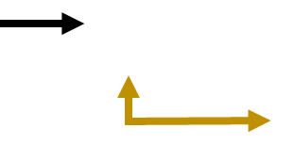

Interactive Summarization! Put the human in the loop
Machine’s processing power + human’s language understanding and preferences

Slide 53
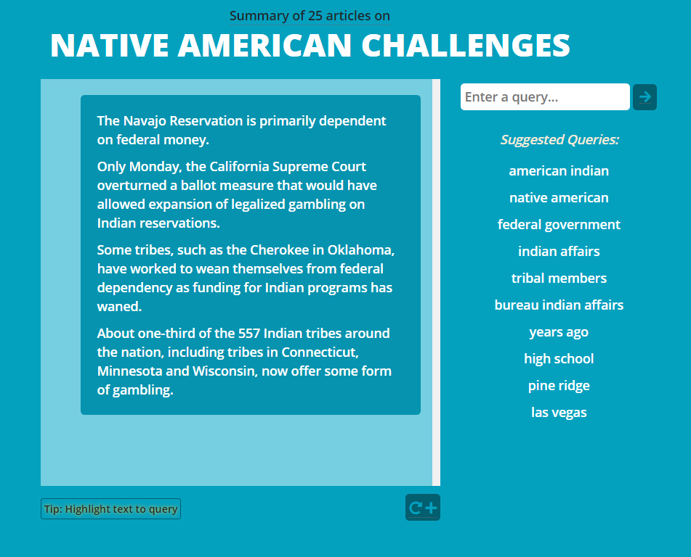
Interactive Summarization Demo
Notes:
Script for demo:
This is an interactive summary of 25 documents on Native American challenges
We first see an initial summary on the topic. It talks about dependence on federal money, legalizing gambling, and federal funding of programs.
We might be interested about gambling, so we highlight this word to form a query and submit it (highlight “gambling” at the very end).
And indeed we get an expansion on this subtopic. Now, we could go deeper into this subtopic by submitting more specific queries, or perhaps we now want to broaden our knowledge and explore another topic.
Let’s click the suggested query on high schools to get more info on that (click “high school” suggested query).
And we can see some statistics on statistics on education in the Native American society.

Slide 54
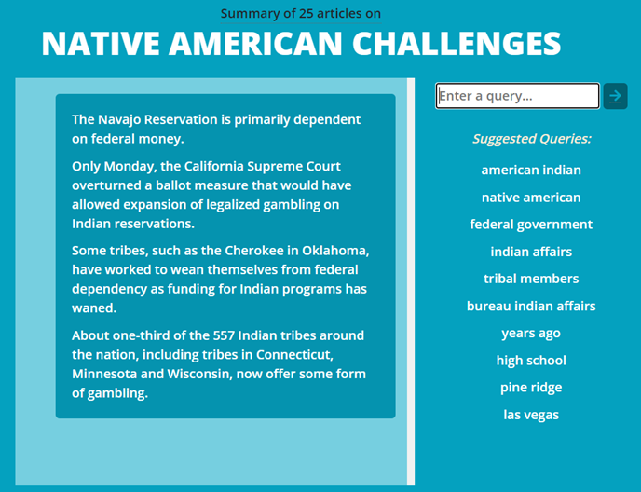
Notes:
We get an initial summary - to major challenges come up: dependency on federal funding and gambling

Slide 55

Notes:
Interested to learn more about the gambling challenge

Slide 56
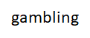

Slide 57
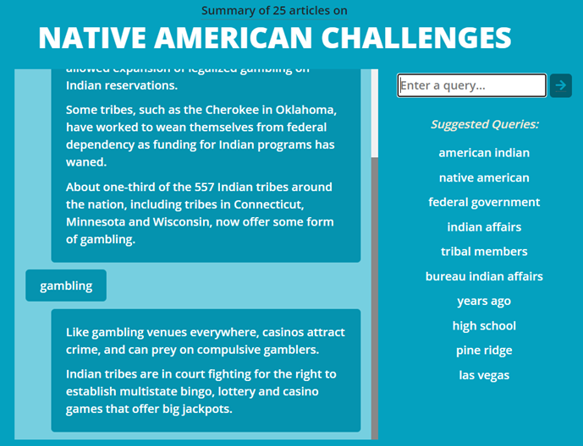


Notes:
Receiving additional query-focused summary expansion about gambling

Slide 58
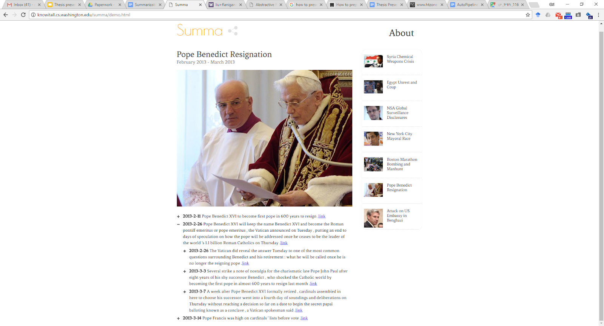
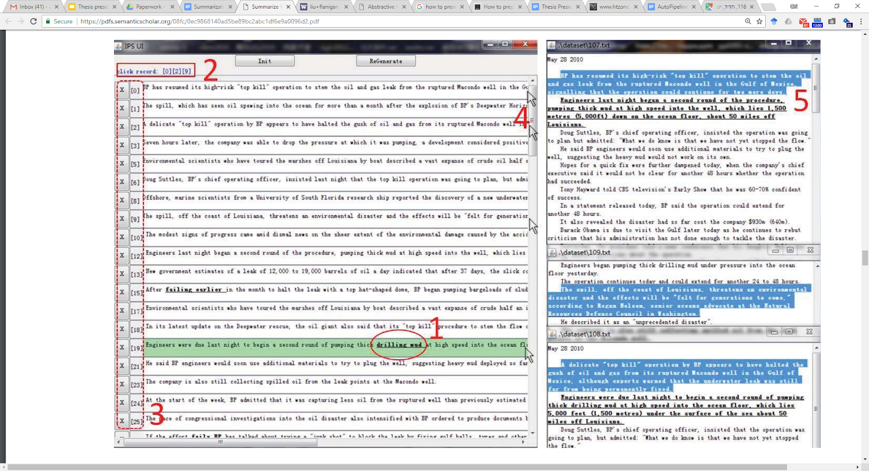
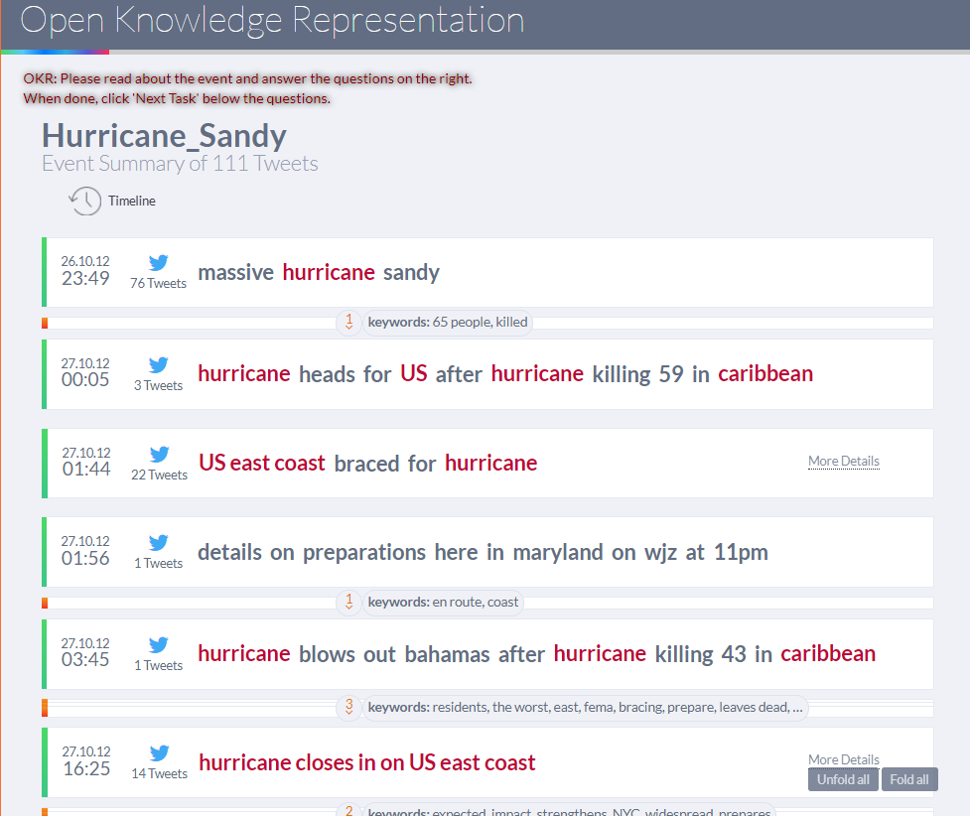
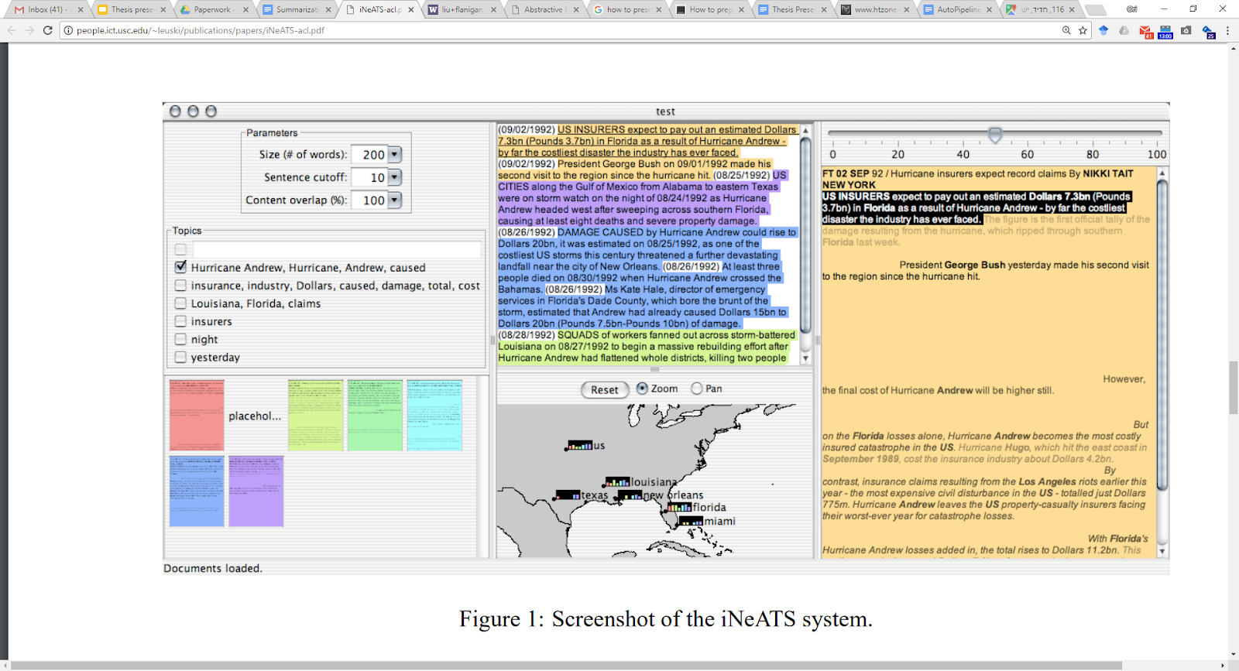
Previous Interactive Summarization Systems
…are all evaluated differently.
Interactive summarization was never formally defined and had no consistent evaluation.
So how should interactive summarization be evaluated?

Slide 59
To formulate the evaluation framework:
Define the Interactive Summarization task
Specifically, “expansion-based interactive summarization”
Devise corresponding evaluation metrics
Automatic and Manual
Establish an effective session collection methodology

Slide 60





Definition: Expansion-based Interactive Summarization
A session can be viewed as an incrementally growing sequence of snapshots.
Initial Summary
2nd Snapshot
3rd Snapshot
Session =
Request 1
Request 2
Response 1
Response 2

Slide 61


Evaluation Framework
Build upon common practices in “static” summarization – and extend to the interactive setting
Using the sequence of static snapshots
Utilizing standard MDS datasets
Utilizing known summarization metrics, applied to each snapshot

Slide 62
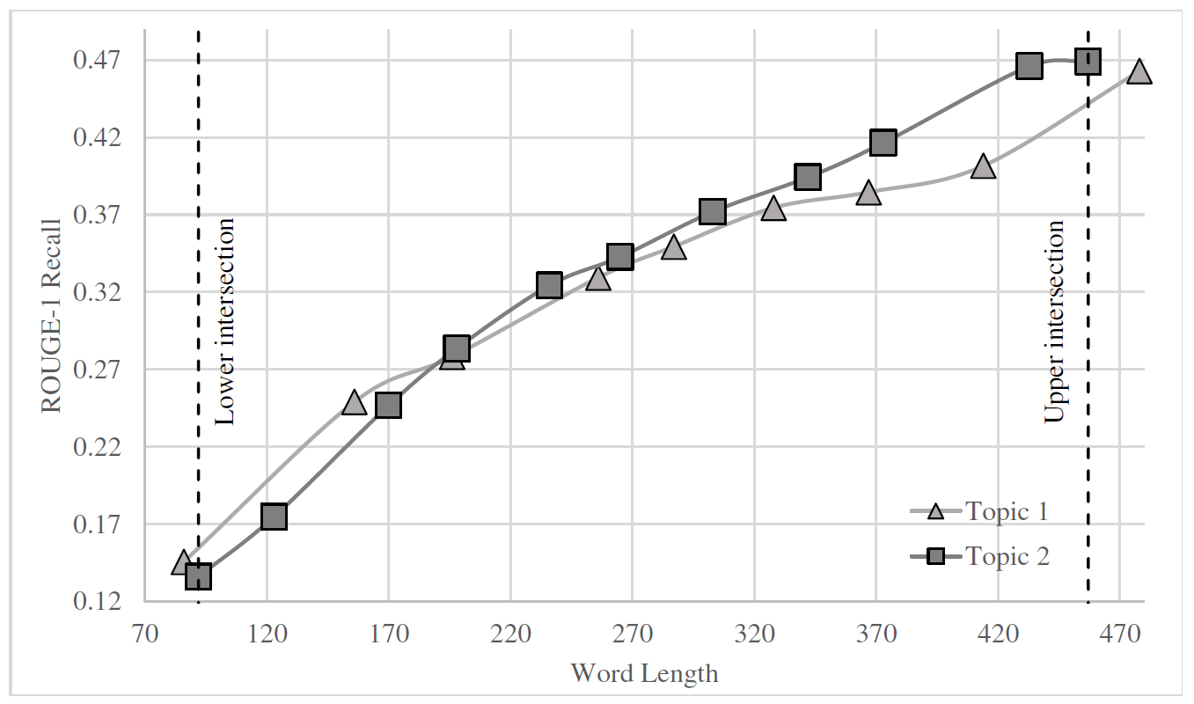
Automatic Measures
Recall-by-length curve (Kelly and Lin, 2007) – against fixed reference summaries
AUC – how fast salient information is acquired
System 1
System 2
Diane Kelly and Jimmy Lin, 2007. Overview of the TREC 2006 ciQA Task. SIGIR.

Slide 63
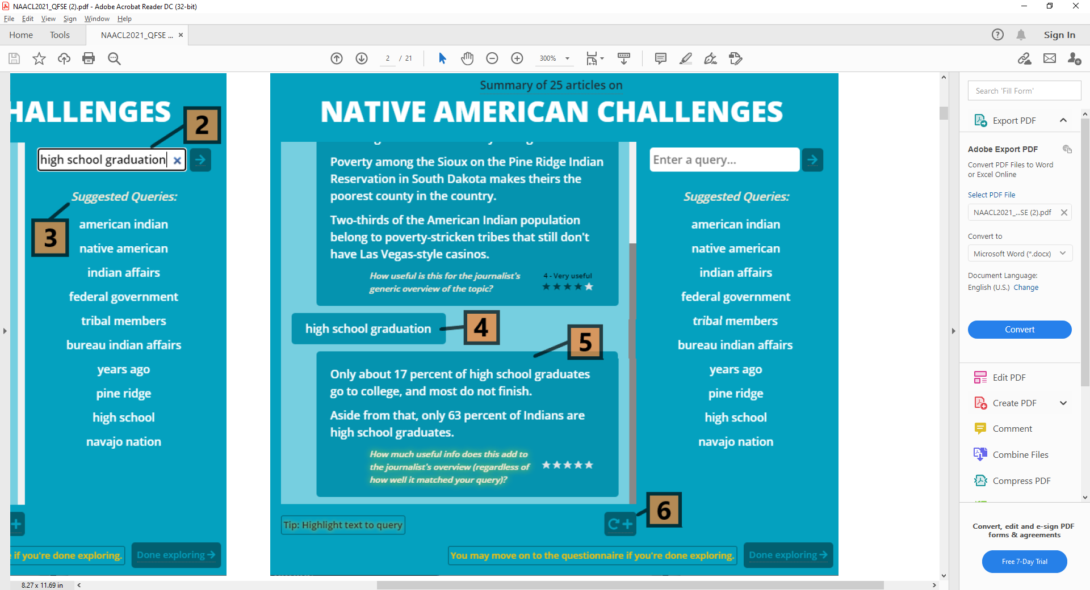
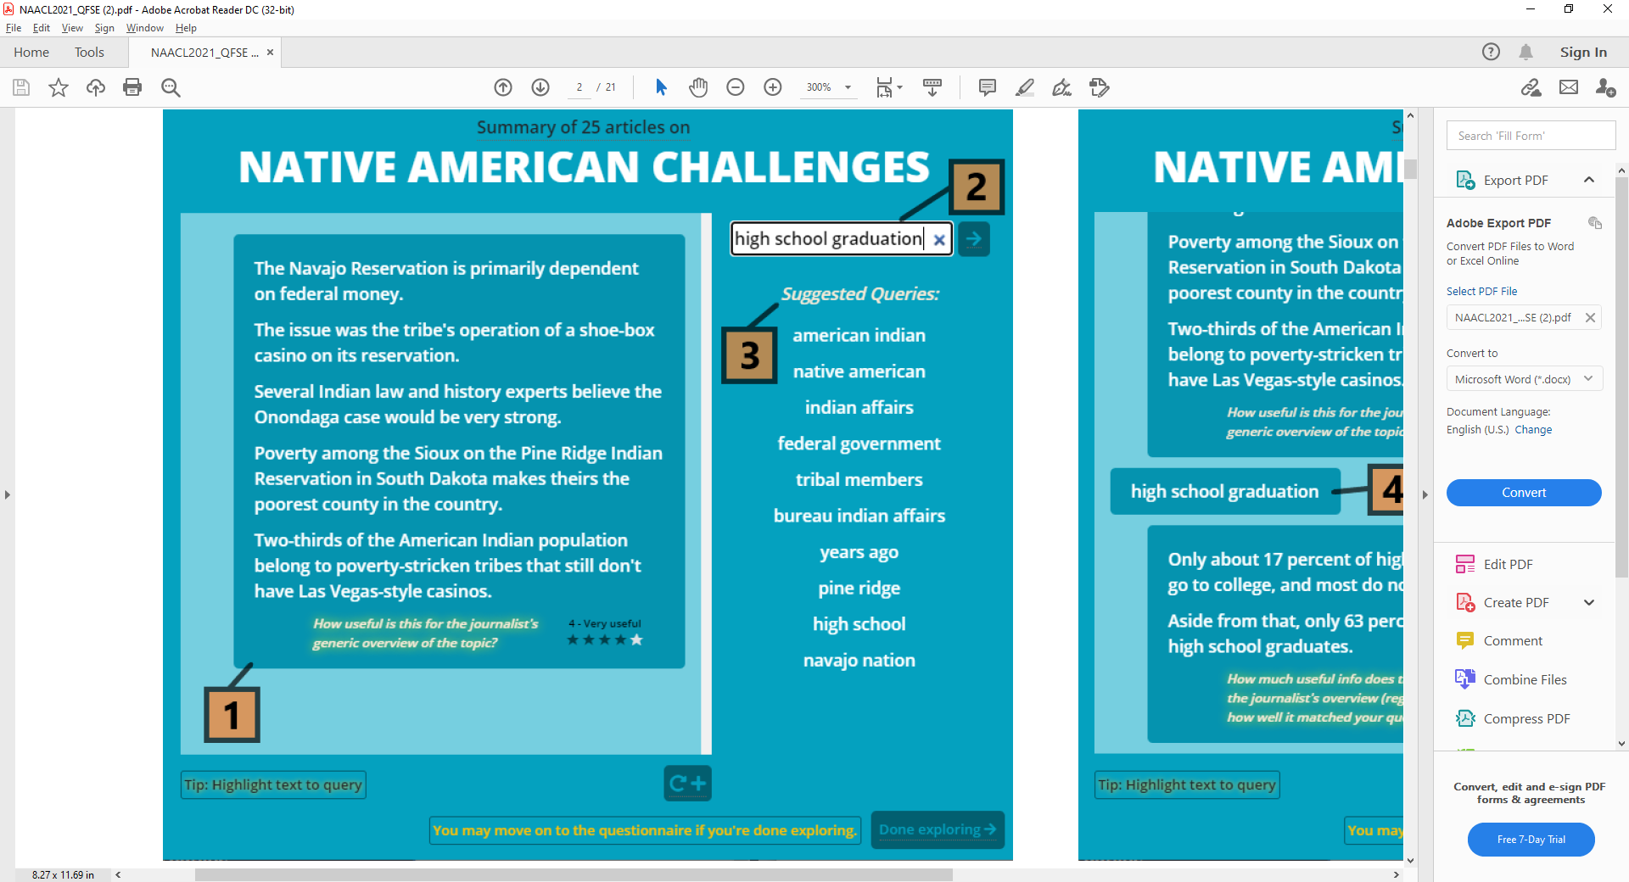
Manual Measures
Several 1-to-5 scores during system-use:
Informativeness
Responsiveness to the requests
Usability

Slide 64

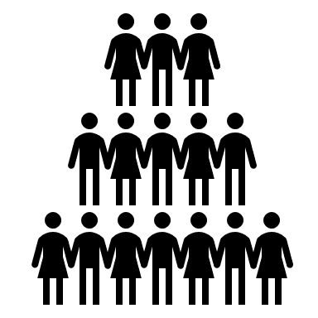
How do we collect sessions on a system?
We need sessions to apply the evaluation
User studies – costly, not scalable, not accessible
Standard crowdsourcing – not reliable enough

Slide 65

Controlled Crowdsourcing!
A gradual process for high-quality session collection (Roit et al., ACL 2020)
Accomplished goals:
Find suitable workers
Train workers to perform interactive sessions
Promote an objective information goal for exploration consistency

Slide 66
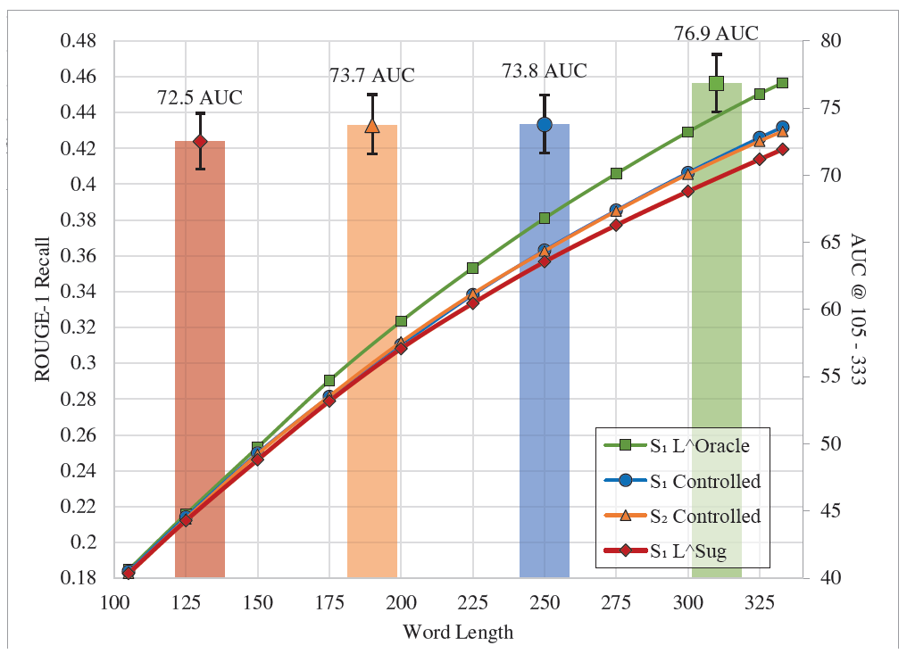
Results
On two implemented systems + upper/lower bound simulations:
The two systems have similar results
They fall between the bounds
There is a trend of consistency between automatic and manual scores

Slide 67
Main Takeaways
Interactive summarization is an important application setting for knowledge exploration
An effective evaluation framework is proposed to facilitate research
Interaction can be useful for many other NLP tasks - benchmarking frameworks for interactive settings should be defined! E.g. RE/IE/KBP, multi-answer QA, sentiment analysis, ...
Notes:
Share our current experience - we use these measures to evaluate new algorithms that we’re developing

Slide 68
Revisiting Semantic & Open Knowledge
Representations
Which representations to benchmark?

Slide 69
Motivation: Historical Perspective
“Meaning” structures in NLP
In feature-based ML - we extracted explicit language structures/features as input to ML
In E2E - letting the network extract relevant structures implicitly (comfort zone!)
Learning is based on data and objectives from:
Pre-training - generic but implied
Fine-tuning - explicit supervision, but task specific
Is this enough?
Seemingly not! E2E models often do not perform well in challenging settings:
tasks requiring deeper semantic understanding, portability, interpretability, control.
“Glass ceiling” is apparent.

Slide 70
What might take us forward?
Seeking better modeling of various meaning phenomena, we may:
Incorporate supervision for generic language aspects, capturing human text understanding
Then leverage such modeling for eventual tasks
Several recent works utilize explicit semantic representations for such goals

Slide 71
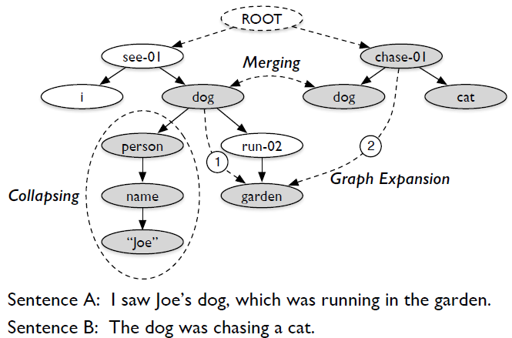
AMR-based summary graphs
(Liu et al., 2015; Liao et. al., 2018)
⇒ I saw Joe’s dog chasing a cat in the garden
Notes:
Based on supervised AMR bank

Slide 72
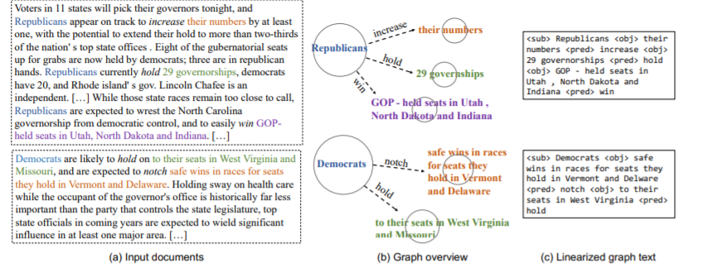
Open Knowledge Graphs
Open-IE based
For summarization faithfulness (Zhu et al., 2021)
For MDS (Pasanuru et. al., 2021)
Notes:
Again, leveraging models trained on supervised OIE data

Slide 73
But which representations should we benchmark?

Slide 74
Traditional Representations: Pre-specified Schemata
Most semantic representations prespecify relation/concept types
Semantic role labels, verb senses, …
Consequences:
Inventories differ
Some arbitrariness?
Requiring expert annotation for training semantic analyzers (!)
Dozen pages of guidelines
Not well understood
By most researchers and application developers
⇒ Hindering the potential use of explicit semantic representations
Notes:
At this point: which representations are most promising for the community to benchmark?

Slide 75
An alternative: NL-based Semantic Representations
Notes:
I’ll describe some evolution of this approach, and will promote it as an appealing direction for benchmarking semantics and open knowledge representation

Slide 76
An alternative: NL-based Semantic Representations
Open Information Extraction (Etzioni et al., 2008) Obama was born in Hawaii in 1961 ⇒ (Obama, born, in Hawaii, in 1961)

Slide 77
An alternative: NL-based Semantic Representations
QA-driven Semantic Role Labeling (QA-SRL) (He et al., 2015; FitzGerald et al., 2018)
Capturing semantic role structures, for verbs
SRL arguments are typically perceived as answering role questions Obama was born in Hawaii in 1961
Who was born? Obama
Where was someone born? Hawaii
When was someone born? 1961
The three question-answer pairs capture the sentence meaning! Note: also reducible to Open-IE (Stanvosky and Dagan, 2016)
Notes:
Who did what to whom, when, where and why
Large dataset, parsing model - generates all QA-SRL pairs for a sentence

Slide 78
Extending QA-SRL to “QA-Sem” (Dagan’s group & colleagues)
QANom - verbal nominalizations (Klein et. al., COLING 2020)
Google’s acquisition of Waze (Who acquired? What was acquired?)
QA-Noun - noun-focused relations (ongoing)
John’s unusual five feet height (Whose height? What height?)
QA-Adj - adjective-focused relations (ongoing)
Luke is good at basketball for his age (Who? What at? Compared to?)
QA-Discourse - discourse-based relations (Pyatkin et. al., EMNLP 2020)
The new regulations spurred demonstrations (What caused demonstrations?)
⇒ Goal: represent “all” text information by decomposition to Q-A pairs

Slide 79
QA-based Cross-document Information Alignment
Entity & event coref
Iranian boats attempt to intercept British oil tanker
who attempts to do something? boats
what does someone attempt? intercept
who may intercept something? boats
what may someone intercept? tanker
…
British Navy thwarts an attack of Iranian vessels on its tanker
who attacks something? vessels
what does someone attacks? tanker
...
Proposition alignment
Via QA alignment
Found benefitial for information merging in sentence fusion
⇒ Towards consolidated QA-based representation for multiple texts

Slide 80
Controlled Crowdsourcing
Found suitable for high quality “natural” annotations
(Roit et al., ACL 2020) for better QA-SRL quality
Followed later in most of our QA-based annotations (and others)
A gradual process, including:
Trap-task for finding suitable annotators (yet non-expert!)
Few training iterations with feedback
Often involving an arbitration or consolidation step
Midpoint between crowdsourcing “in the wild” and expert annotation

Slide 81
Goal: Benchmark “Natural” Semantic Representations
Key: based on natural-language expressions rather than on formal schemata
Exemplified by the QA-based approach, for meaning decomposition
Relevant for modeling many other semantic & knowledge aspects
Scalable and reliable annotation - via controlled-crowdsourcing
Support developing semi-structured explicit semantic representations:
Amenable for LM-based embeddings and modeling
Yet enabling explicit & explainable operations (content selection, generation, ...)
Midway between formal and opaque representations
Provide generic task-independent infrastructure
Notes:
Exemplify: discourse connectives, factuality, modality, operator scope

Slide 82
Overall Conclusion
Benchmarking guides research, and how a field proceeds
As NLP may be at a crossroad, approaching its next glass ceiling:
Benchmarks should push research to confront realistic challenging settings
Expansion to interactive settings can substantially broaden NLP impact
It’s time to revisit semantic and (open) knowledge representations
Semi-structured NL-based representations become appealing!

